Slide 1
Present Simple: 3rd Person Singular Verb Endings
HE / SHE / IT
Welcome to your guide on He/She/It verb endings in the Present Simple tense! In English, when we talk about one other person or thing, the verb changes its form. This poster will show you exactly how and when to add -s, -es, or -ies to verbs. By the end, you'll be able to spot the patterns, practise with real examples, and feel confident using these endings in your own speaking and writing. Let's get started!

Slide 2
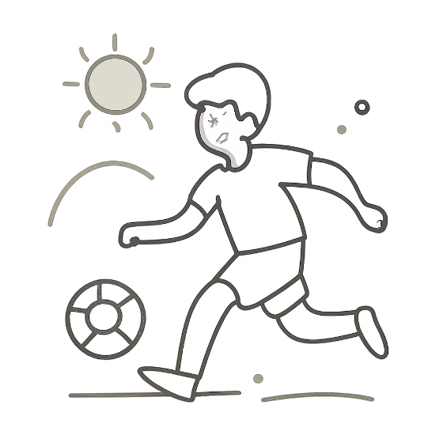



When Do We Use He / She / It?
We use He / She / It with verbs in the Present Simple tense to talk about things that are generally true or happen regularly. This includes daily routines, habits, facts, and things that are always or often true. For example, if something happens every day, every week, or is simply a fact about the world, we use the Present Simple. Remember: He, She, and It are third person singular — they each refer to just one person or thing. That is why the verb needs a special ending!
He 👦
She 👩
It 🐱
Refers to one boy or man. We use "he" when talking about a male person. Example: He plays football every day.
Refers to one girl or woman. We use "she" when talking about a female person. Example: She reads books every evening.
Refers to one animal or thing. We use "it" for animals, objects, or anything that is not a person. Example: It sleeps on the sofa.
Remember: He / She / It = one person or thing. Always use a changed verb form with these pronouns!

Slide 3

Base Verb vs He / She / It Form
In English, the verb form changes depending on who is doing the action. For I / You / We / They, we use the base verb — the plain form with no ending. But for He / She / It, we must change the verb by adding -s or -es. This is one of the most important grammar rules in English! Look at the comparison below to see the difference clearly.
I / You / We / They
He / She / It
Use the base verb — no change needed!
Add -s or -es to the verb!
I play football.
You read every day.
We watch TV together.
They go to school.
He plays football.
She reads every day.
He watches TV.
She goes to school.
I / You / We / They
add -s / -es
use base verb
He / She / It
This diagram shows the key difference: the subject pronoun determines whether the verb stays the same or gets an ending. Always check who is doing the action before choosing your verb form!

Slide 4
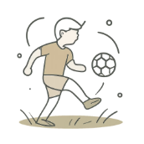

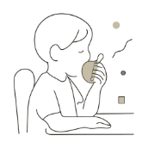


Most Verbs: Just Add -S
For most verbs in English, the rule is simple — just add -s to the end of the base verb when using He / She / It. This is the most common pattern, so it is a great place to start! Look at these everyday examples. Notice how the verb gets a little longer with an -s at the end.
play → plays
read → reads
eat → eats
run → runs
He plays football every Saturday. ⚽
(play + s = plays)
She reads a book every night. 📖
(read + s = reads)
He eats an apple for snack time. 🍎
(eat + s = eats)
He runs to school every morning. 🏃
(run + s = runs)
💡 Top Tip: Add -s to most verbs. It's the easiest rule — just one letter!

Slide 5

Verbs Ending in -s, -sh, -ch, -tch, -x: Add -ES
Some verbs need -es instead of just -s. If a verb ends in -s, -sh, -ch, -tch, or -x, we always add -es. This is because these endings make a hissing or buzzing sound, and adding just -s would make the word difficult to pronounce. Adding -es creates an extra syllable, making the word easier to say! Here are some common examples to learn.
watch → watches
catch → catches
She watches TV after school. 📺
ends in -ch → add -es
He catches the ball every time. ⚾
ends in -ch → add -es
wash → washes
fix → fixes
He washes his hands before dinner. 🙌
ends in -sh → add -es
She fixes the broken toy. 🔧
ends in -x → add -es
Here are a few more verbs that follow this rule: kiss → kisses, push → pushes, teach → teaches, mix → mixes. Can you think of any others? Try making your own sentences with these verbs!
🔤 Rule: -s / -sh / -ch / -tch / -x → add -es

Slide 6
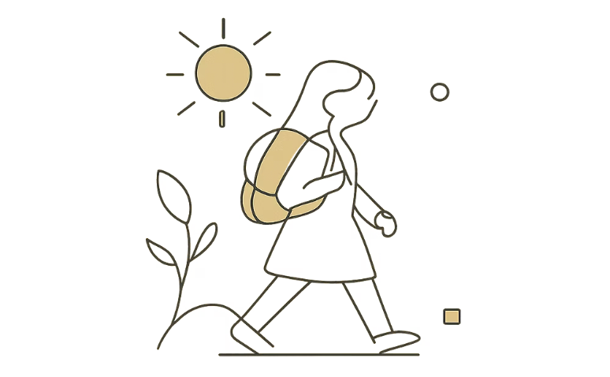


Verbs Ending in -O: Add -ES
Verbs that end in the letter -o also take -es in the He / She / It form. There are not many of these verbs in English, but the two most important ones are go and do. These are very common verbs that you will use every day, so it is important to remember their special forms! Think of it this way: adding -es after -o makes the word easier to say — try saying "goes" and "does" out loud!
go → goes
do → does
She goes to school at 8 o'clock. 🏫
He goes home after class. 🏠
go + es = goes
He does his homework every day. ✏️
She does yoga in the morning. 🧘
do + es = does
She goes to school.
He does his homework.
Every morning at 8 o'clock — it's her daily routine! 🎒
He always does it carefully after dinner. 📚
⚠️ Watch out! "Does" is pronounced /dʌz/ — not "do-es". The spelling changes, and so does the sound!

Slide 7

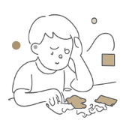



Consonant + Y: Change -Y to -IES
When a verb ends in a consonant + y, we remove the -y and add -ies for He / She / It. A consonant is any letter that is not a vowel (a, e, i, o, u). So if the letter before -y is a consonant like d, r, t, or p, the -y changes to -ies. This rule helps the word sound smoother and more natural when we say it. Look at the visual guide below to see the transformation step by step!
Start: try
Remove the Y
Add -IES: tries
This diagram shows the three steps clearly: first identify the verb, then drop the -y, and finally add -ies. Practice this pattern until it feels natural!
try → tries
study → studies
fly → flies
He tries his best in every lesson. 💪
try → remove y → add ies = tries
She studies English every evening. 📚
study → remove y → add ies = studies
The bird flies over the school. 🐦
fly → remove y → add ies = flies
⚠️ Exception: If the verb ends in vowel + y (like play or stay), just add -s: he plays, she stays. The -y does NOT change!

Slide 8





Quick Practice: Choose the Correct Verb!
Time to test yourself! Look at each picture and sentence, then circle the correct verb. Remember the rules: most verbs add -s, verbs ending in -s/-sh/-ch/-x/-o add -es, and consonant + y changes to -ies. Take your time and think about which rule applies to each one. Check your answers below after you decide!
He ___ football.
She ___ TV.
It ___ in the sky.
Choose: play or plays?
✅ Answer: He plays football. (Most verbs → add -s!)
Choose: watch or watches?
✅ Answer: She watches TV. (Ends in -ch → add -es!)
Choose: fly or flies?
✅ Answer: It flies in the sky. (Consonant + y → -ies!)
🎉 Well done! How many did you get right? Keep practising — you're doing great!

Slide 9
Mini Reminder: Your Cheat Sheet
Keep this handy summary close by whenever you need a quick reminder of the He / She / It verb rules. These three patterns cover all the verb changes in the Present Simple tense for third person singular. Review them often and soon they will become second nature! You can even cover the right column and test yourself on the rules.
Verb Ending
Rule
Example
Most verbs
Add -s
play → plays
-s / -sh / -ch / -tch / -x
Add -es
watch → watches
-o
Add -es
go → goes
Consonant + y
Change to -ies
study → studies
Vowel + y
Add -s (no change!)
play → plays
-S
-ES
-IES
Most verbs
-s, -sh, -ch, -x, -o
Consonant + y
Notice how the table and the boxes both show the same three main rules. The table gives you detailed examples, while the boxes give you a quick visual summary. Use whichever format helps you remember best!

Slide 10
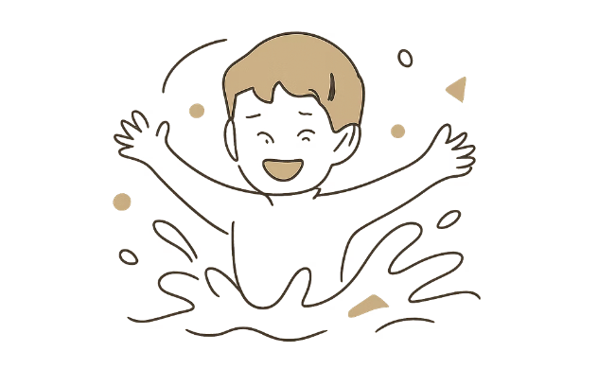
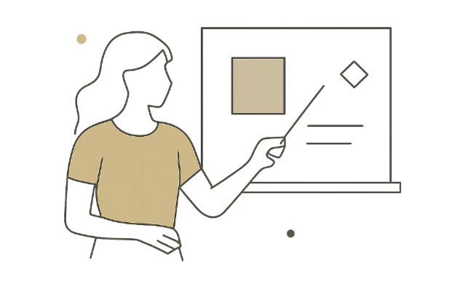
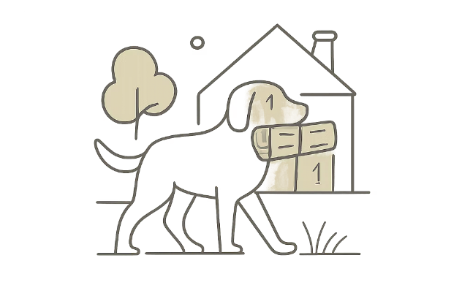
Finish Strong: Spot It! 🔍
Look at each scene below and fill in the blank with the correct verb ending. Circle -s, -es, or -ies on your poster. Then say the full sentence out loud! This is your final challenge — use everything you have learned on this poster to complete each one correctly.
He swim___ in the pool.
She teach___ English.
It carr___ the newspaper.
Circle: -s / -es / -ies
✅ He swims in the pool. 🏊
Circle: -s / -es / -ies
✅ She teaches English. 👩‍🏫
Circle: -s / -es / -ies
✅ It carries the newspaper. 🐕
🌟 "He / She / It makes verbs change!" — Remember this golden rule and you'll never forget! Keep practising every day and soon these endings will feel completely natural. You've got this! 💪

