Slide 1
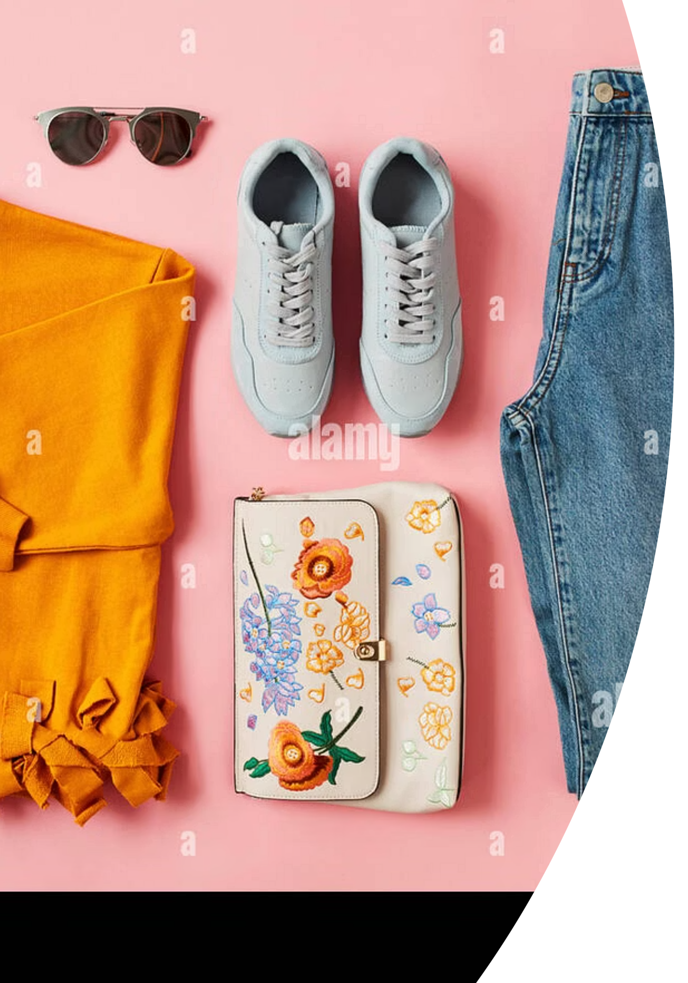
Fashion and Style: Your Personal Identity
Explore the language of clothes — from materials and patterns to sizes and accessories. Discover how what you wear tells the world who you are.
A1–A2 ENGLISH
10TH GRADE

Slide 2
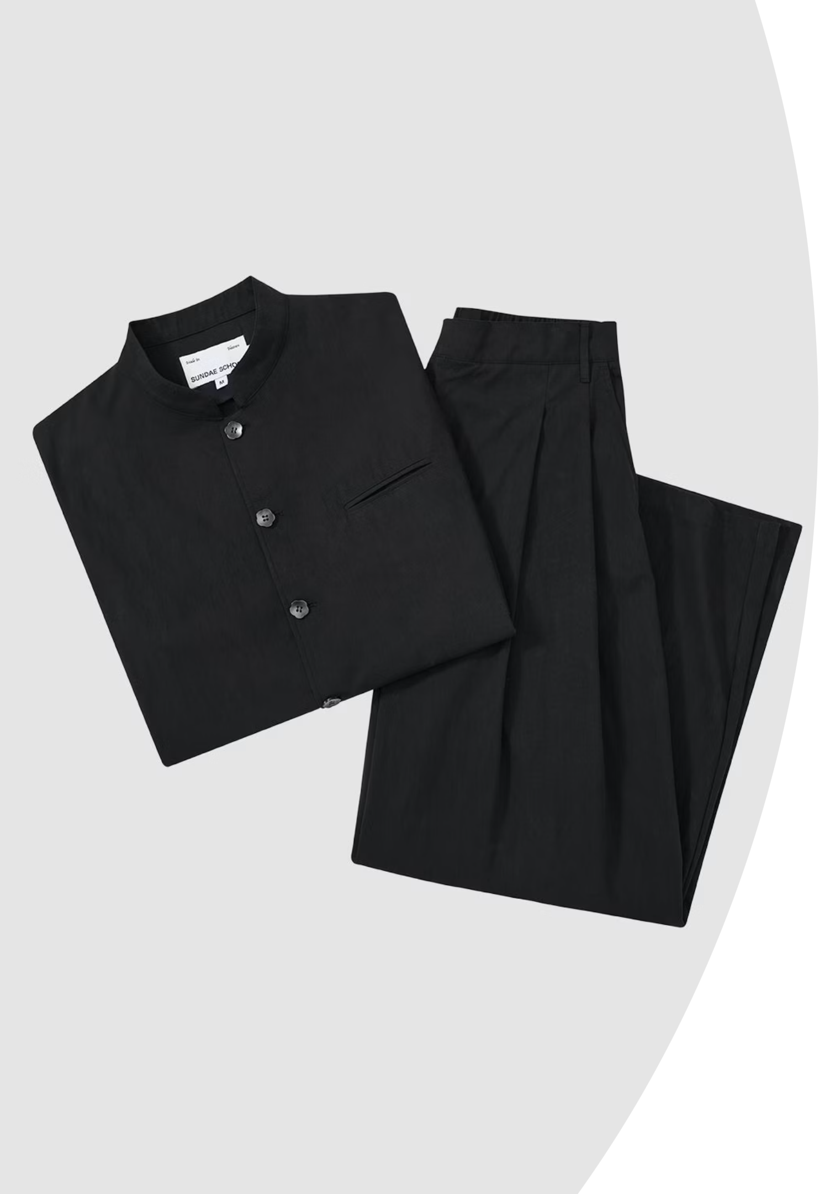
Wardrobe Essentials: Getting Started
👖 Clothing
👟 Footwear
Jeans — casual trousers
Blouse — smart top
Jacket — outer layer
Suit — formal outfit
Boots — sturdy shoes
High heels — elegant shoes
Slippers — indoor shoes
🏫 Everyday Wear
From school uniforms to daily outfits — knowing the basics helps you describe what people are wearing.

Slide 3


Accessories: The Finishing Touch
Functional Items
Belts — hold trousers in place
Scarves — keep your neck warm
Gloves — protect your hands
Style or Function?
Some accessories are practical — like gloves in winter. Others are purely for style — like a statement necklace. A simple outfit can look completely different with the right accessory!
There was an error generating this image
💬 Discuss: What accessory do you always wear?

Slide 4


Materials and Textures
Denim
Leather
Wool
Cotton
Strong cotton fabric used for jeans and jackets.
Durable material from animal skin — used for jackets and boots.
Warm, soft fabric from sheep — perfect for winter coats.
Light, breathable fabric — great for T-shirts and blouses.
🔍 Vocabulary Check: What material is your favourite shirt made of?

Slide 5
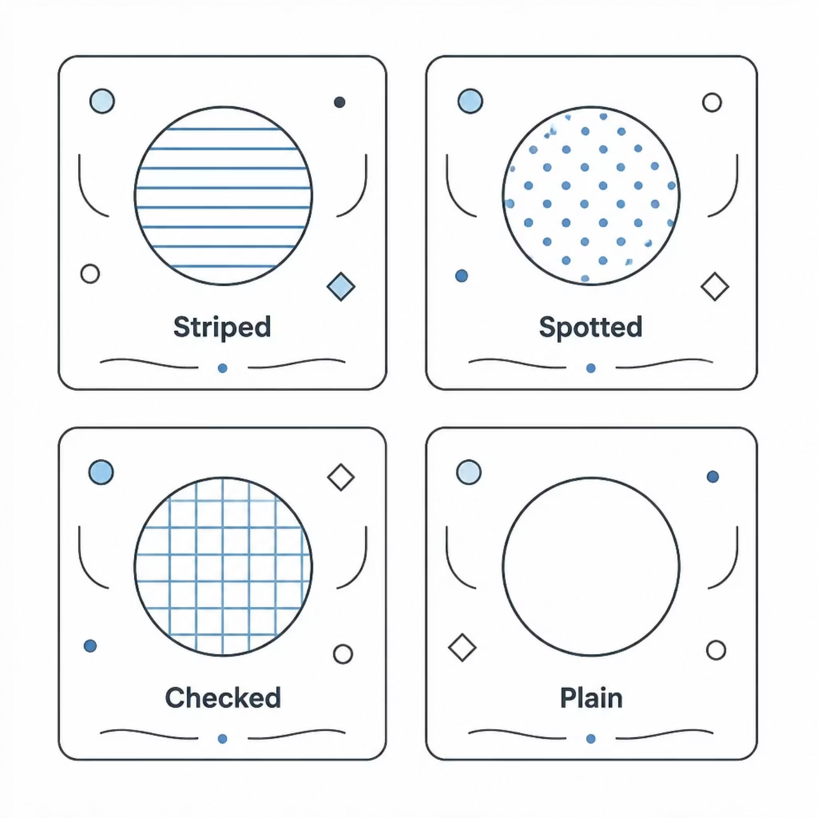

Patterns and Prints
Can you match the pattern?
Look at the four most common patterns found on clothing. Each one gives a garment a different look and feel.
Striped — lines running across or down
Spotted — small dots all over
Checked — a grid of squares
Plain — one colour, no pattern
💬 Discuss: What patterns do you like to wear? Why?

Slide 6
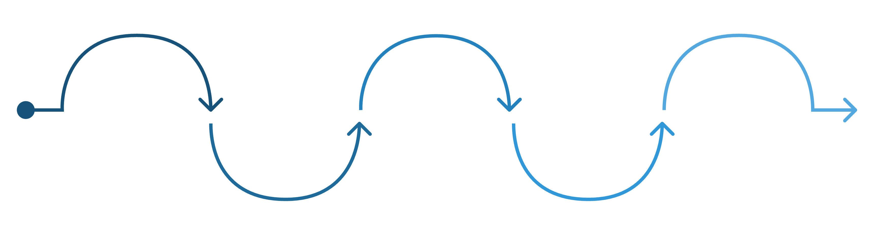
Describing Clothes: Order of Adjectives
In English, adjectives follow a specific order. Remember this rule:
Opinion
Pattern
Type
beautiful
Colour
striped
Material
shirt
blue
cotton
✨ Example
✏️ Your Turn
"A beautiful blue striped cotton shirt"
Opinion → Colour → Pattern → Material → Type
Look at a photo of an outfit. Write your own description using at least four adjectives in the correct order.

Slide 7

Fit and Measurements
📏 Size Guide
Describing the Fit
Loose — not tight, lots of room
Tight — fits closely to the body
Baggy — very loose and hanging
Well-fitting — just right for your body
S — Small
M — Medium
L — Large
XL — Extra Large
Choosing the right size helps you feel comfortable and confident.

Slide 8
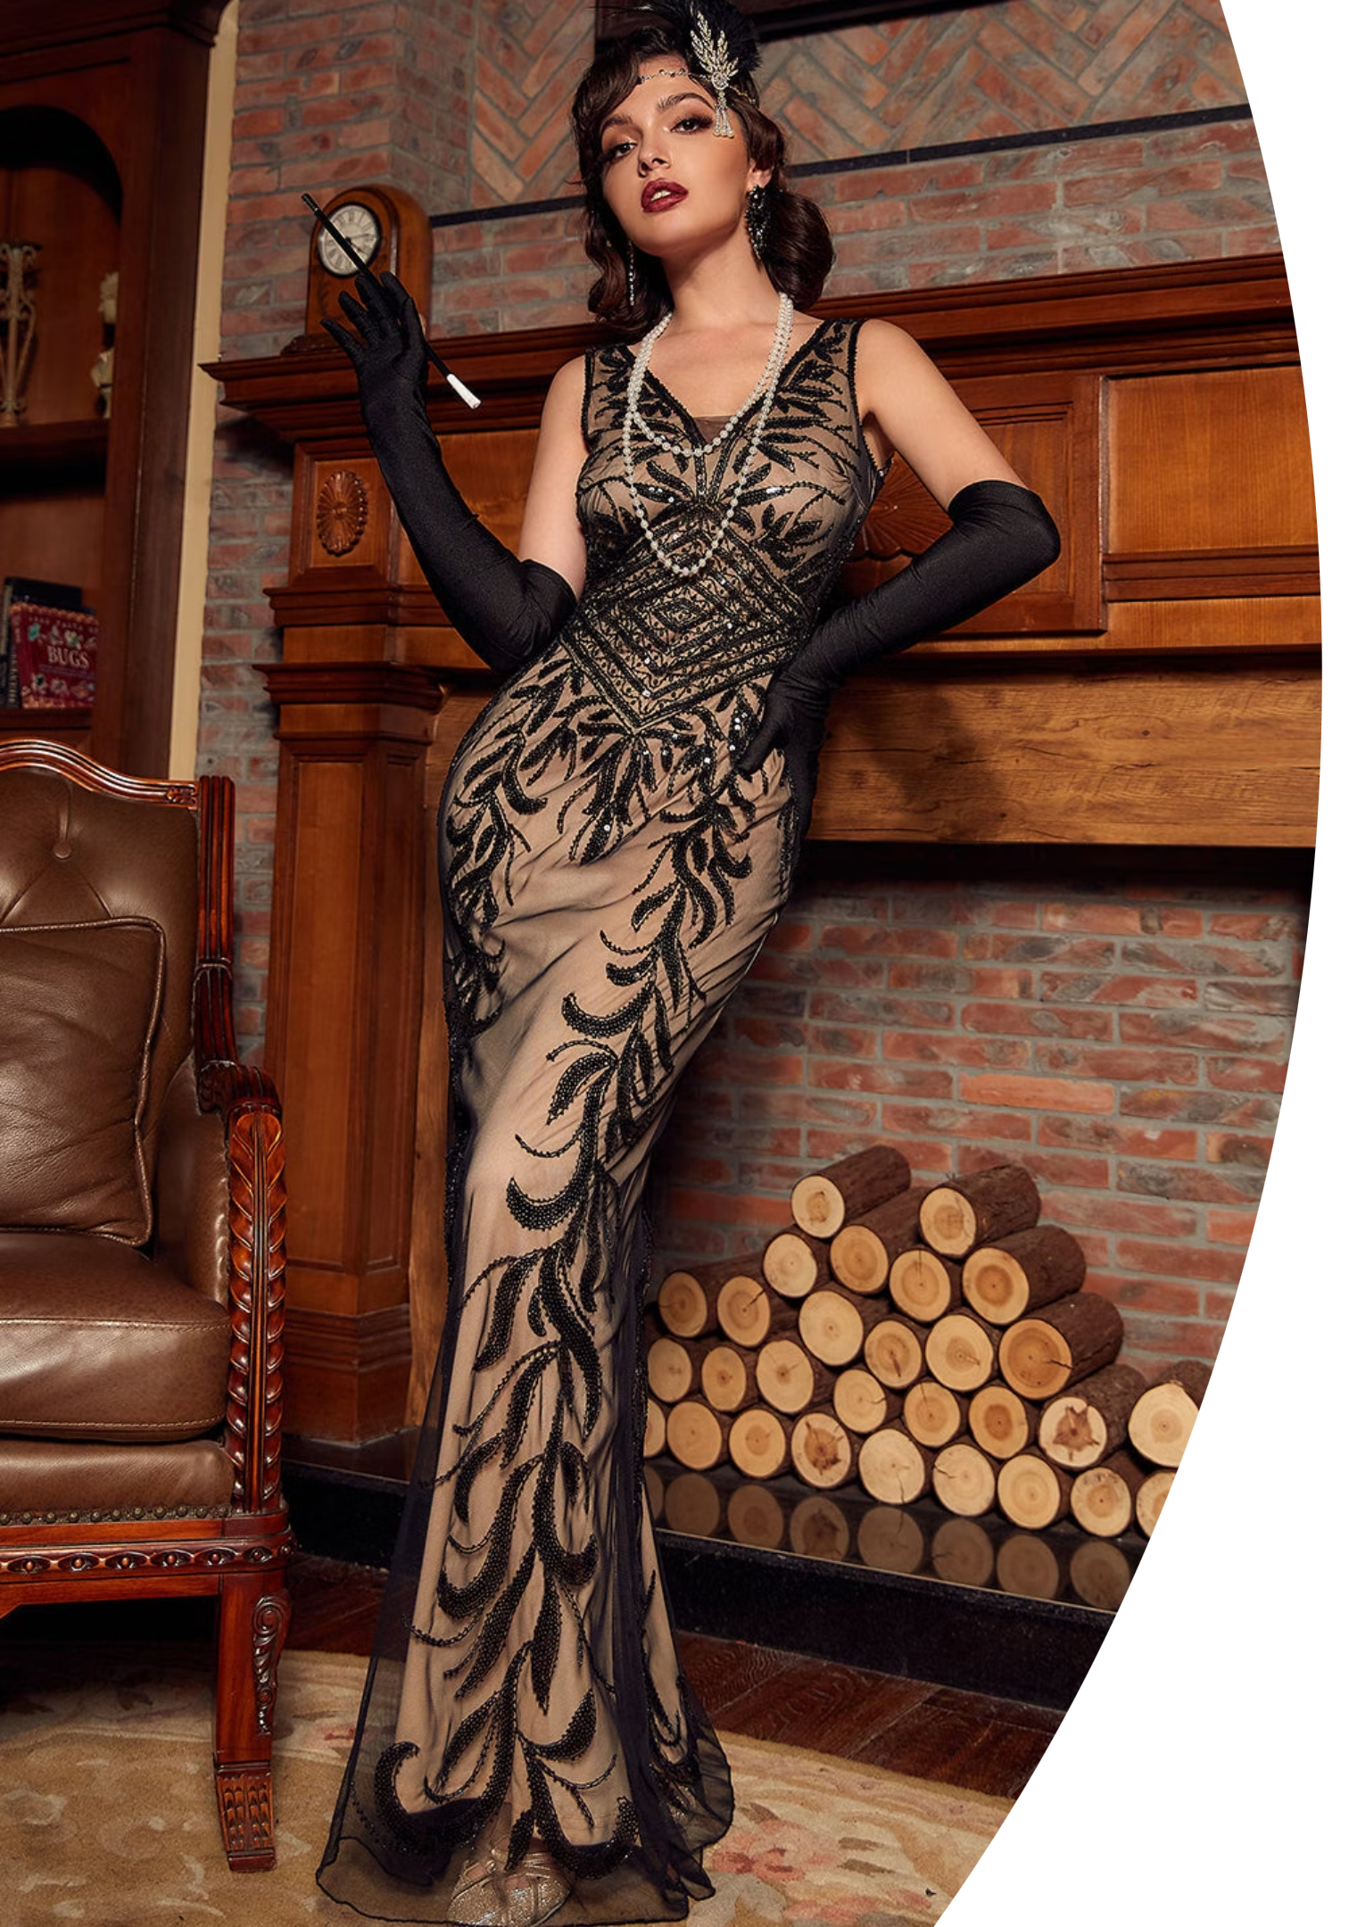
Contextual Style: Dressing for the Occasion
🎩 Formal Wear
👟 Casual Wear
Tuxedos and gowns for prom, weddings, and fancy parties. Smart, elegant, and polished.
T-shirts and jeans for school, hangouts, and everyday life. Comfortable and relaxed.
💼 Smart Casual
A blouse with smart trousers for a job interview. Professional but not too formal.
🤔 Activity: What would you wear to a job interview vs. a sports event?

Slide 9

Fashion in Action: Interactive Challenge
1
2
3
Guess the Outfit
Pair Work Interview
Quick Quiz
Describe a person in a photo using at least three adjectives. Use the adjective order rule!
Ask your classmate: "What's your favourite brand? What style do you prefer?" Report back to the class.
Identify the clothing category of ten mystery items. Is it footwear? An accessory? A pattern?
⏱️ You have 10 minutes for all three activities. Work together and have fun!

Slide 10
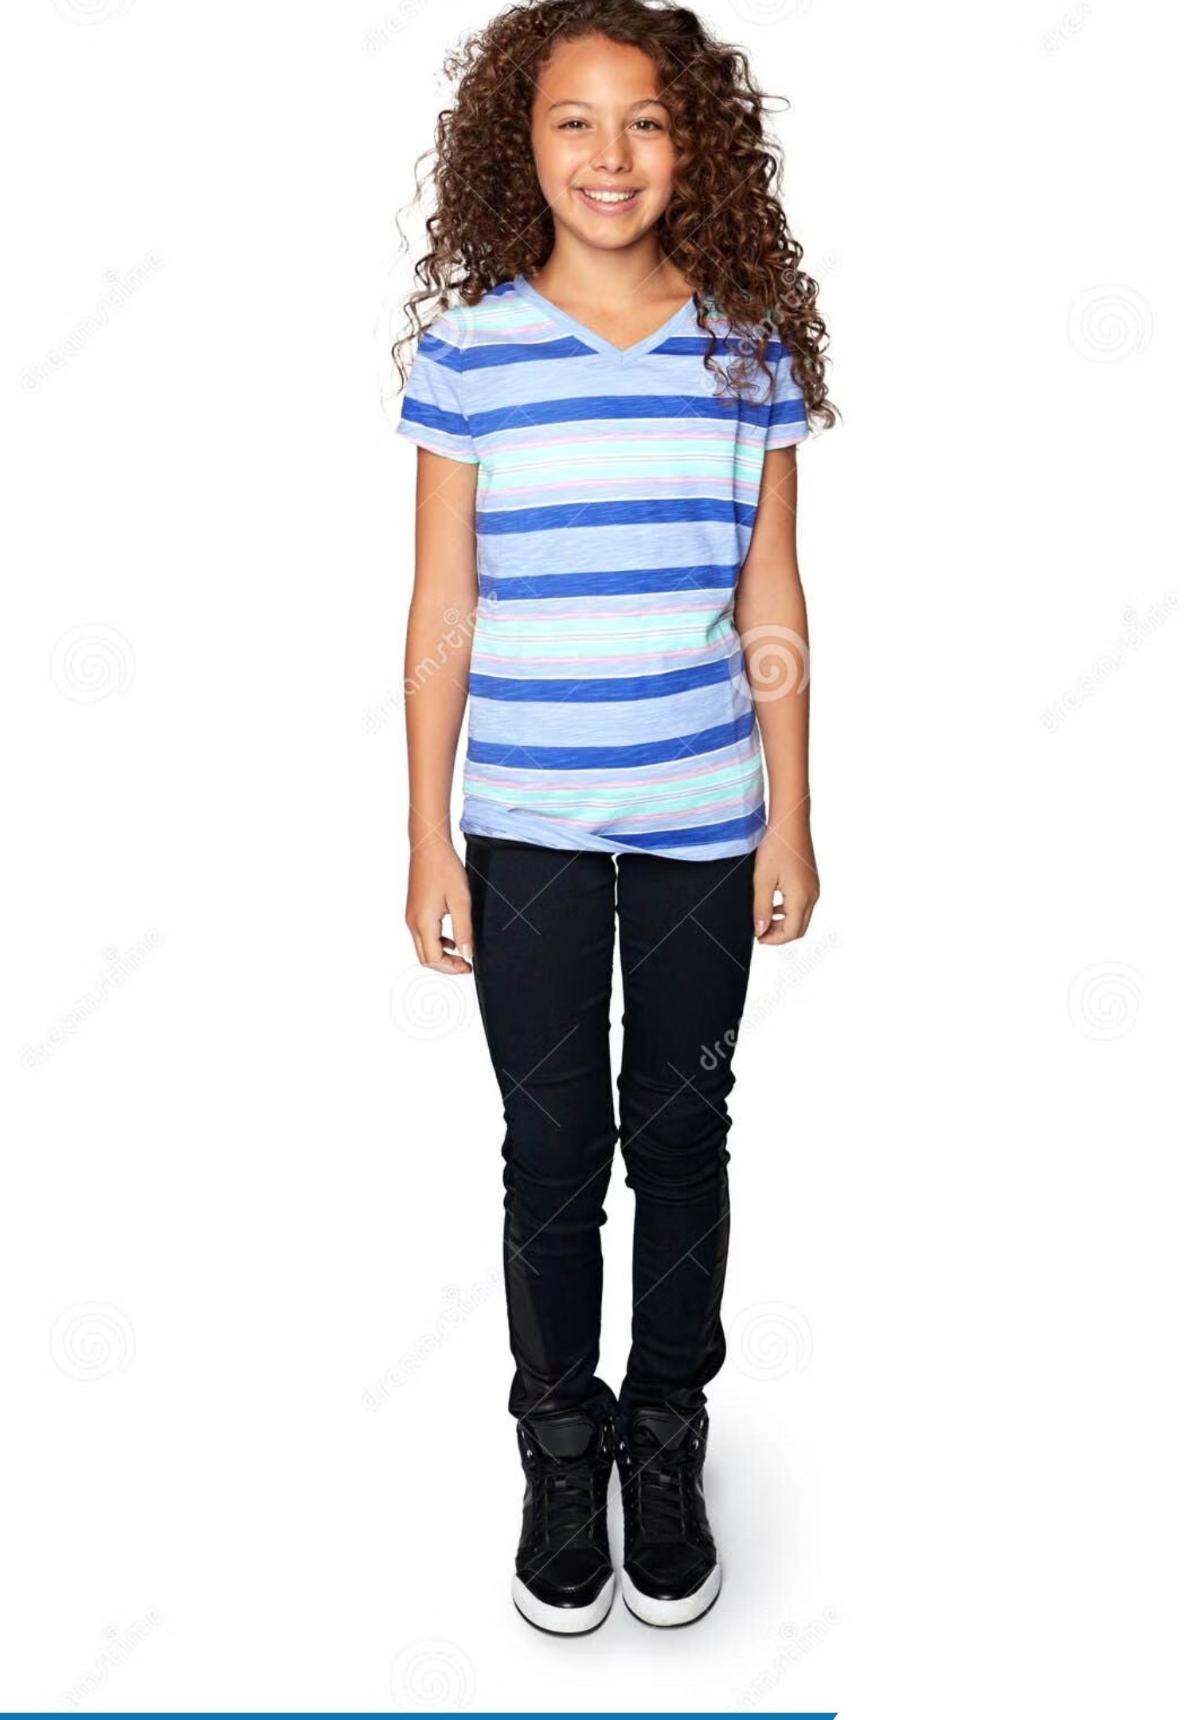

Conclusion: Wear Your Confidence
Vocabulary Recap
We covered materials (denim, wool, cotton), fits (loose, tight, baggy), patterns (striped, checked), and accessories (belts, scarves).
Fashion is Personal
Style is not just about clothes — it's about how you feel and how you express yourself to the world.
🎨 Your Challenge
Design your dream outfit for the next class fashion show. Describe it using today's vocabulary!

