Slide 1
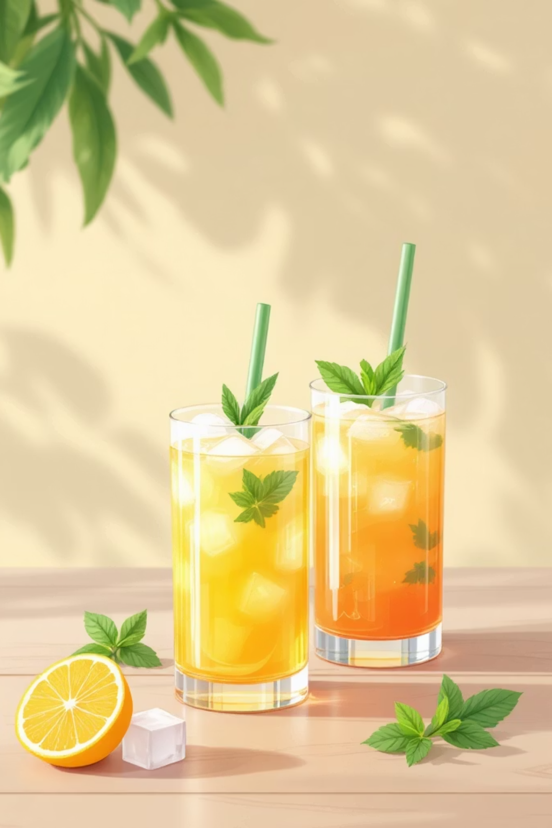
Alcohol-Free Cocktail Masterclass
Welcome to this 45-minute practical session where we'll explore the art of crafting four refreshing non-alcoholic cocktails. From the classic Shirley Temple to the tropical Piña Colada, you'll master essential techniques including proper garnishing, glass chilling, and presentation skills that will impress any guest.

Slide 2

Essential Equipment & Ingredients
Glassware
Mixing Tools
Long drink glasses, highball glasses, and hurricane glasses for proper presentation
Jigger for precise measurements, bar spoon for stirring, and cocktail shaker for mixing
Ice
Garnishes
Cubed ice for chilling glasses, crushed ice for texture, and ice tongs for handling
Fresh fruit (oranges, limes, pineapple), cocktail cherries, mint leaves, and straws
Before we begin, ensure you have grenadine syrup, lime juice, orange juice, pineapple juice, coconut milk, heavy cream, simple syrup, ginger ale, and soda water ready at your station.

Slide 3
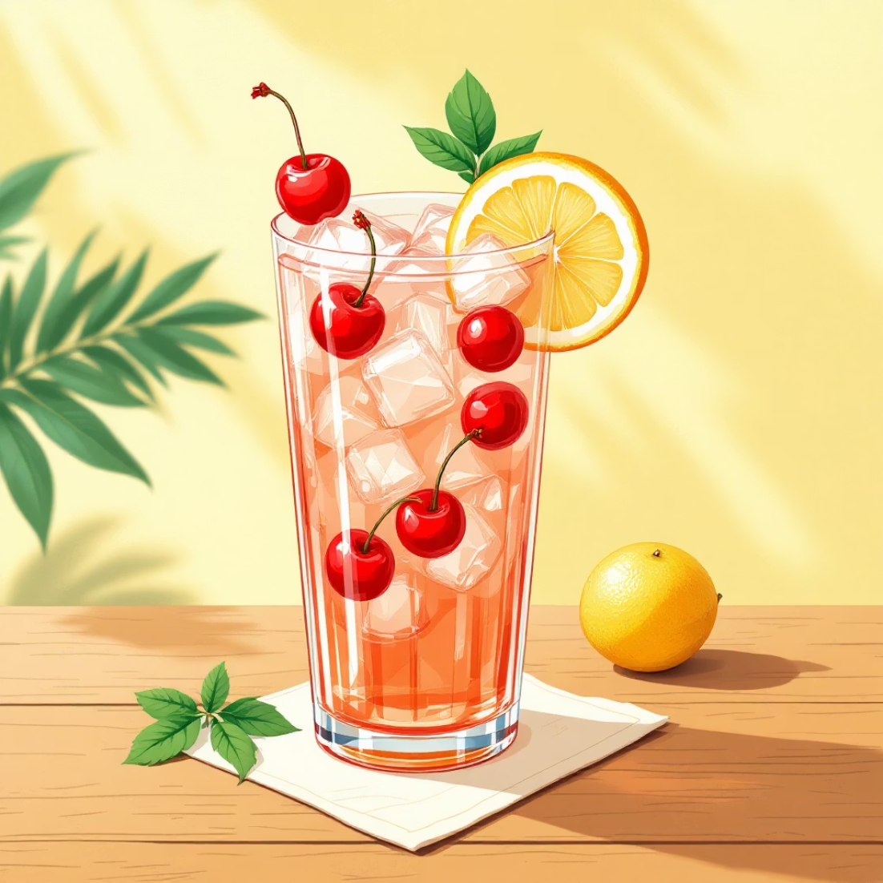
Shirley Temple
Ingredients & Glassware
Long drink glass
2 cl grenadine syrup
2 cl fresh lime juice
Kinley ginger ale (to top)
Cocktail cherries for garnish
Key Techniques Demonstrated
Glass chilling, precise measuring, gentle stirring, and professional garnishing
01
02
Prepare Garnish
Chill the Glass
Skewer 3-4 cocktail cherries onto a cocktail stick. This creates visual appeal and makes serving easier.
Fill the long drink glass with ice cubes and give them a light stir. Allow 30-45 seconds for the glass to chill properly, then pour out the water.
03
04
Measure & Mix
Final Presentation
Working at the bar where guests can see, measure grenadine and lime juice into the chilled glass. Top with ginger ale and stir gently with a bar spoon.
Place the cherry garnish on top and use cocktail tongs to insert a straw. Serve immediately for best presentation.

Slide 4
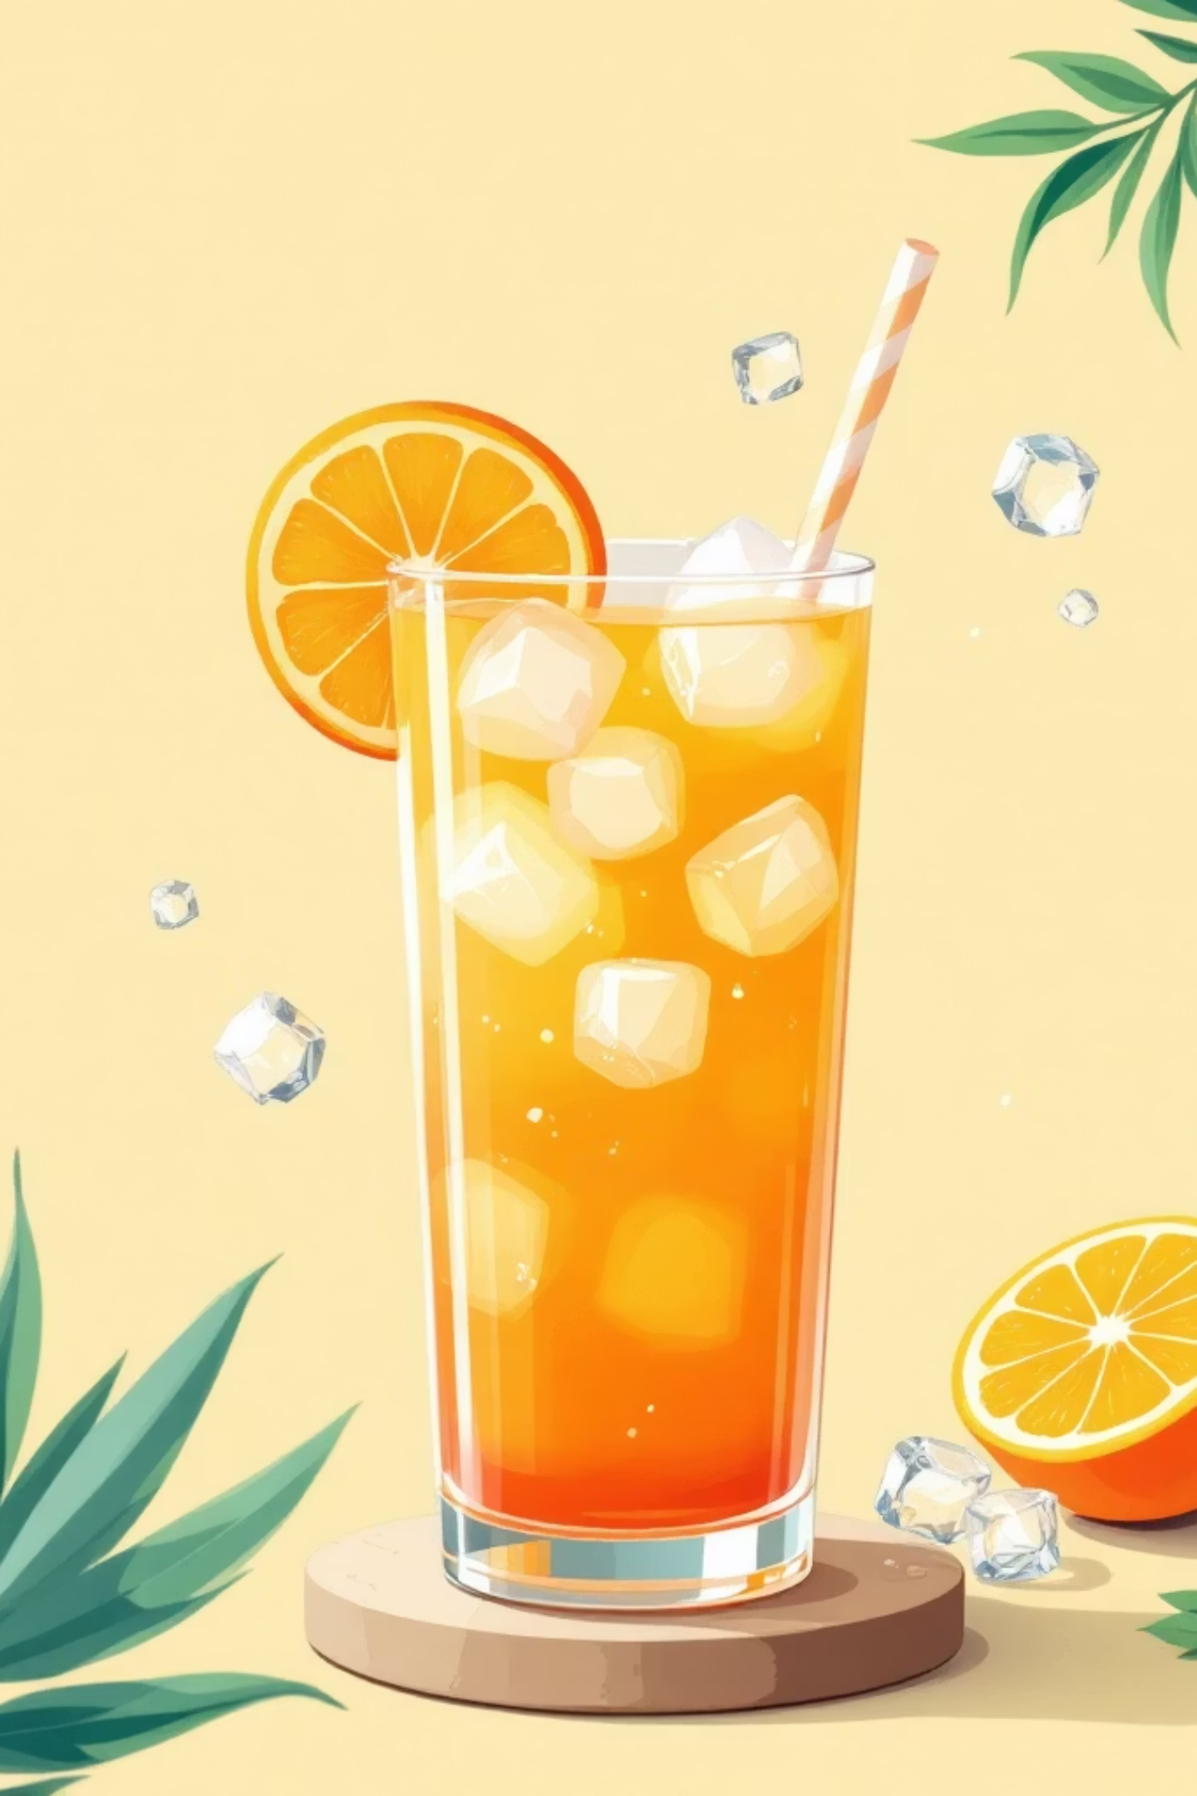
Lucky Driver
Ingredients
Preparation Steps
8 cl orange juice
8 cl pineapple juice
2 cl lime juice
1-2 cl grenadine syrup
Half orange slice for garnish
Prepare orange garnish by cutting half a slice
Chill glass with ice, then shaker with ice
Add all ingredients except grenadine
Shake thoroughly and strain
Color Variation Options
With grenadine: Add during mixing for uniform pink colour
Without grenadine: Pour over top with spoon for gradient effect
Pour out water from the chilled glass, then serve the shaken drink over fresh ice in front of the guest. Garnish with the orange slice and straw using tongs. Important: Always ensure ice remains in the glass when pouring.

Slide 5
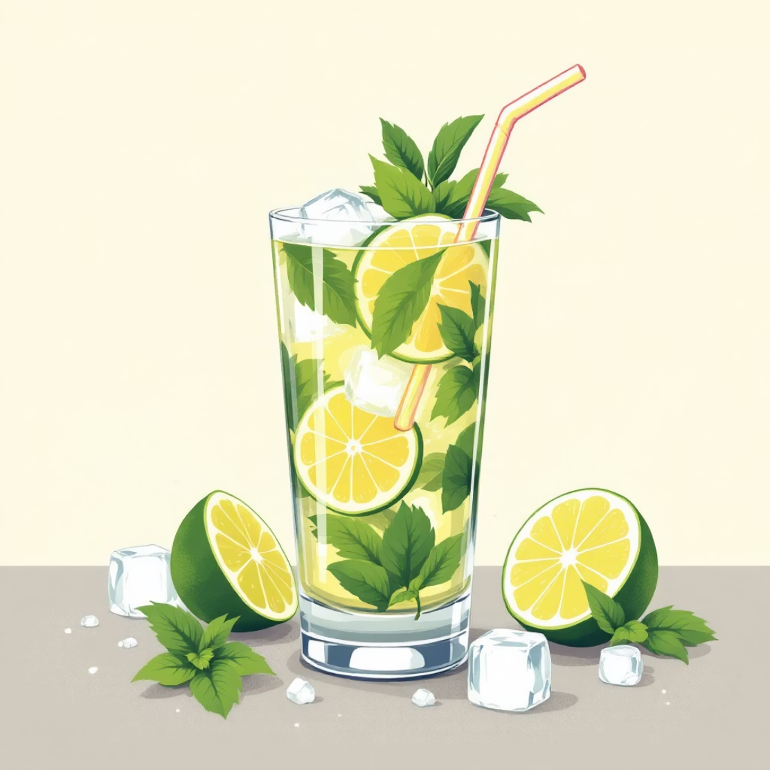




Non-Alcoholic Mojito
Ingredients
1 lime (halved and sliced)
4-5 fresh mint leaves
3-4 cl simple syrup
Crushed ice
Soda water
Lime wedge and mint leaf for garnish
Cut & Prepare
Chill & Crush
Halve the lime, slice one half, and quarter the other half for muddling
Fill glass with ice, chill, then crush ice and remove from glass
Muddle
Finish
Add lime and mint leaves, gently muddle to release flavours
Add syrup, ¾ crushed ice, top with soda water, stir gently 2-3 times
Always garnish with lime wedge and mint leaf using tongs. The key is gentle stirring to preserve carbonation bubbles.

Slide 6
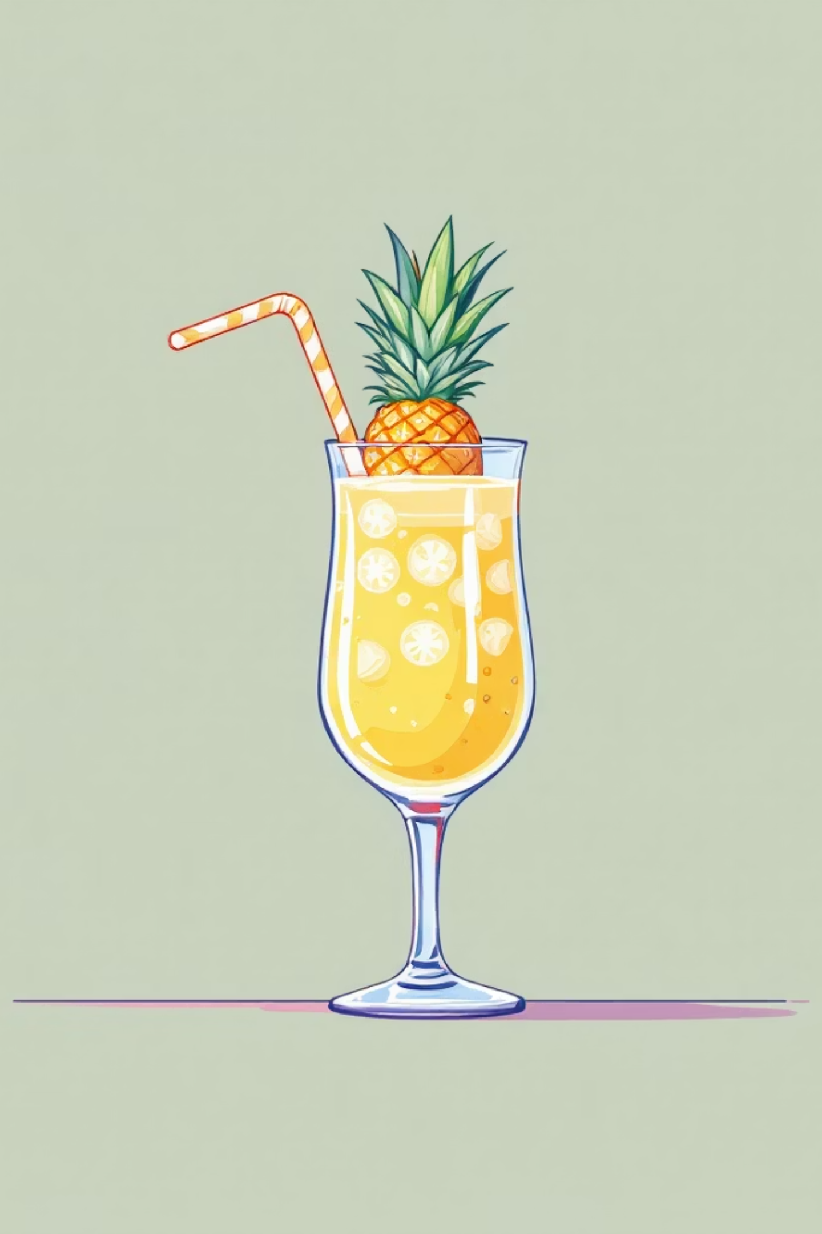
Non-Alcoholic Piña Colada
Ingredients
4 cl heavy cream
4 cl coconut milk
12 cl pineapple juice
Fresh pineapple for garnish
Technique Focus
Shaker chilling with ice
Layering ingredients properly
Straining into chilled glass
Dramatic presentation
1
Prepare Garnish
Cut fresh pineapple chunks for decorative topping
2
Chill Glass & Shaker
Fill serving glass with ice, chill shaker with ice and shake briefly
3
Add Ingredients
Pour out water, add cream, coconut milk, and pineapple juice to shaker
4
Shake & Serve
Shake vigorously, strain into chilled glass over ice, garnish professionally

Slide 7
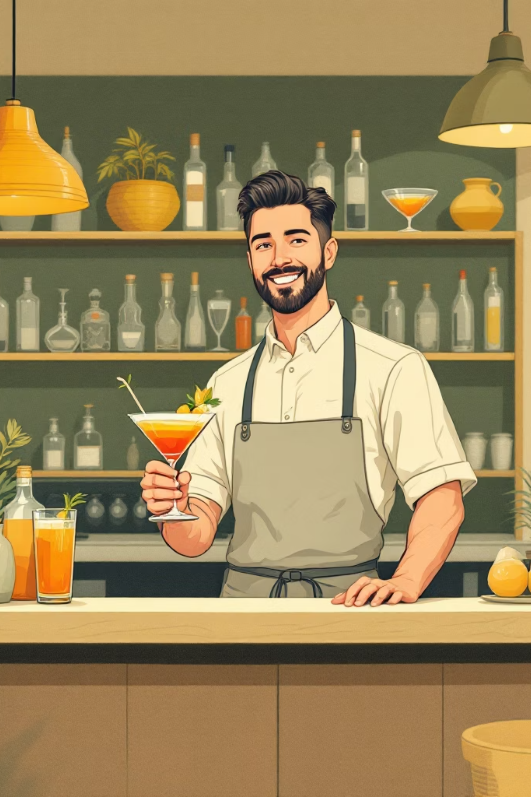
Professional Presentation Techniques
Glass Chilling
Always chill glasses before serving. Fill with ice, stir briefly, then pour out condensation water. This ensures drinks stay cold longer and prevents dilution.
Guest Visibility
Work at the bar counter where guests can watch the preparation. This builds anticipation and showcases your professional skills, creating an engaging experience.
Tongs Usage
Never touch garnishes or straws with bare hands. Use cocktail tongs for hygienic, professional presentation that maintains food safety standards.
Ice Management
Always serve over fresh ice. Remove melted water from glasses before pouring finished drinks. This maintains proper dilution levels and drink temperature.

Slide 8

Common Mistakes to Avoid
Skipping Glass Chilling
Over-Stirring Carbonated Drinks
Not chilling the glass beforehand results in rapid melting and over-dilution. Always take 30-45 seconds to properly chill before serving.
Excessive stirring pops bubbles in ginger ale and soda water. Stir gently 2-3 times maximum to preserve carbonation and mouthfeel.
Incorrect Ice Usage
Rushing Garnish Placement
Using the wrong ice type or forgetting fresh ice in the serving glass compromises texture and temperature. Match ice type to cocktail requirements.
Dropping garnishes instead of placing them carefully with tongs looks unprofessional. Take extra seconds for precise, elegant presentation.
Professional Tip: Practice your garnish technique with dummy ingredients before working with actual drinks. Muscle memory develops through repetition, leading to confident, flawless service.

Slide 9
Practice Session Guidelines
Timing Practice
Station Setup
Time yourself preparing each cocktail. Aim for 2-3 minutes per drink from start to finish, including garnish placement.
Organise your workspace with all ingredients, tools, and glassware within easy reach. Create a clean, efficient workflow area.
Quality Check
Peer Review
Evaluate each cocktail for proper proportions, correct ice usage, professional garnish, and overall presentation before moving to the next drink.
Work in pairs, with one preparing while the other observes. Provide constructive feedback on technique, presentation, and timing.
Focus Areas
Success Criteria
Consistent ingredient measurements
Smooth, confident movements
Visual appeal of final product
Efficient time management
Drinks prepared within 3 minutes
Proper glass chilling demonstrated
Professional garnish placement
Correct ice usage in all cocktails

Slide 10
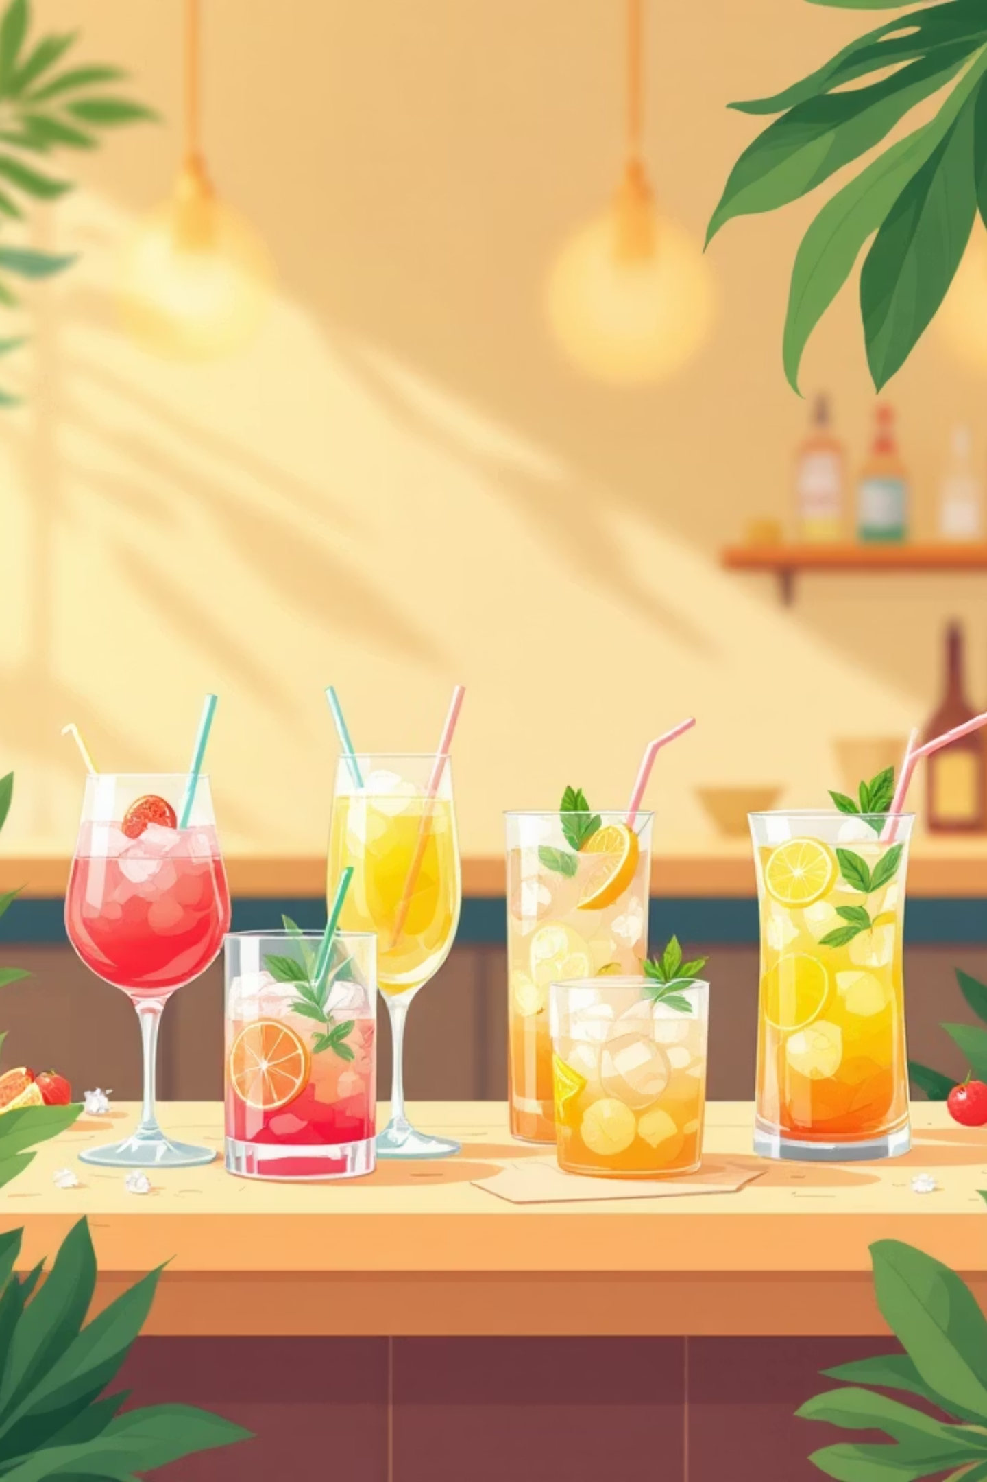
Key Takeaways & Next Steps
Mastered Techniques
Four Cocktails Ready
Glass chilling, precise measuring, gentle stirring, professional garnishing, and guest-facing preparation methods
Shirley Temple, Lucky Driver, Mojito, and Piña Colada - all alcohol-free recipes perfected
Professional Standards
Hygienic practices using tongs, proper ice management, and engaging presentation skills
Homework Assignment
Practice all four cocktails at home, focusing on consistent timing and presentation. Record yourself preparing one cocktail and review your technique. Identify one area for improvement and practice it specifically before next class.
Next session: We'll explore classic alcoholic cocktails, building upon the foundational skills you've mastered today with non-alcoholic preparations.

